Slide 1

Notes:
The last comment block of each slide will be treated as slide notes. It will be visible and editable in Presenter Mode along with the slide. [Read more in the docs](https://sli.dev/guide/syntax.html#notes)

Slide 2
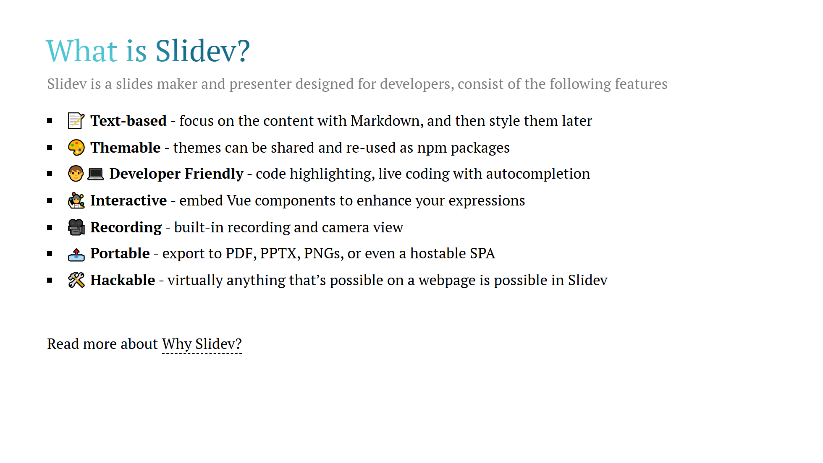
Notes:
Here is another comment.

Slide 3
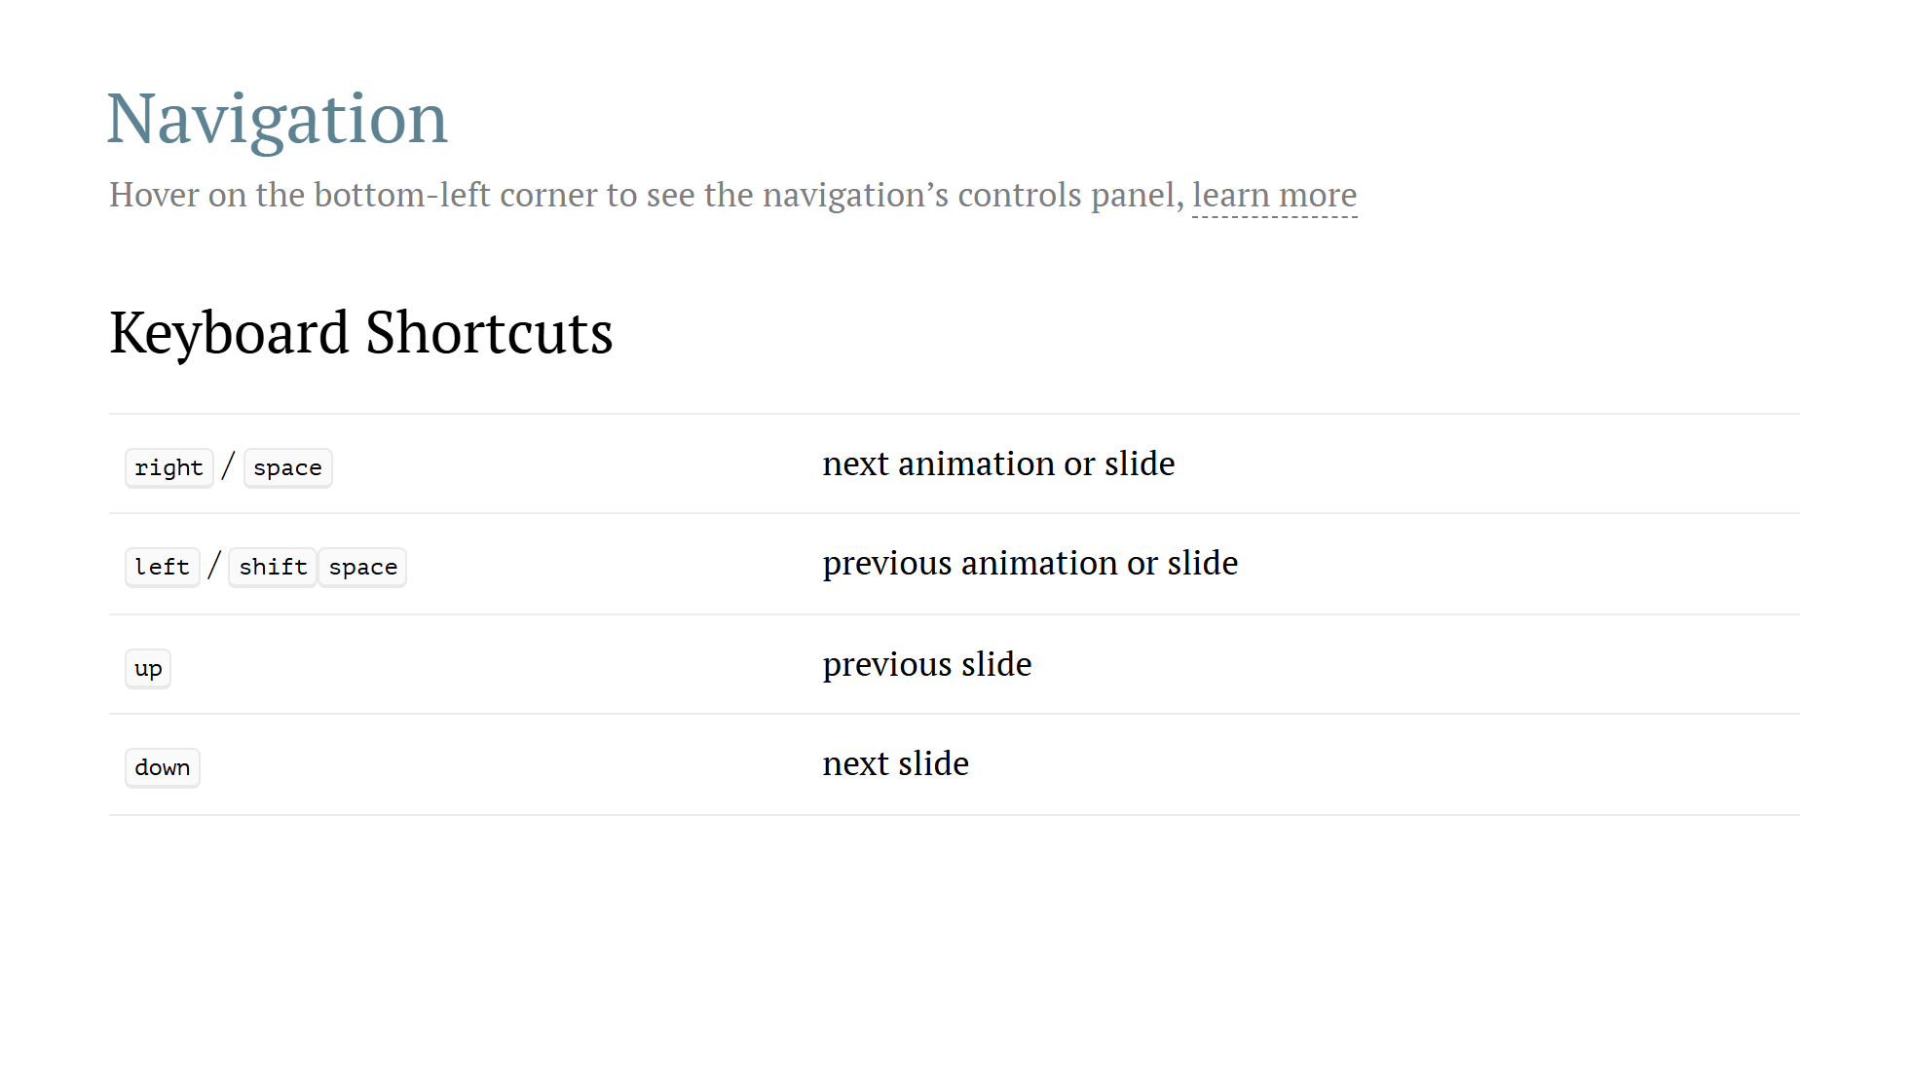

Slide 4


Slide 5
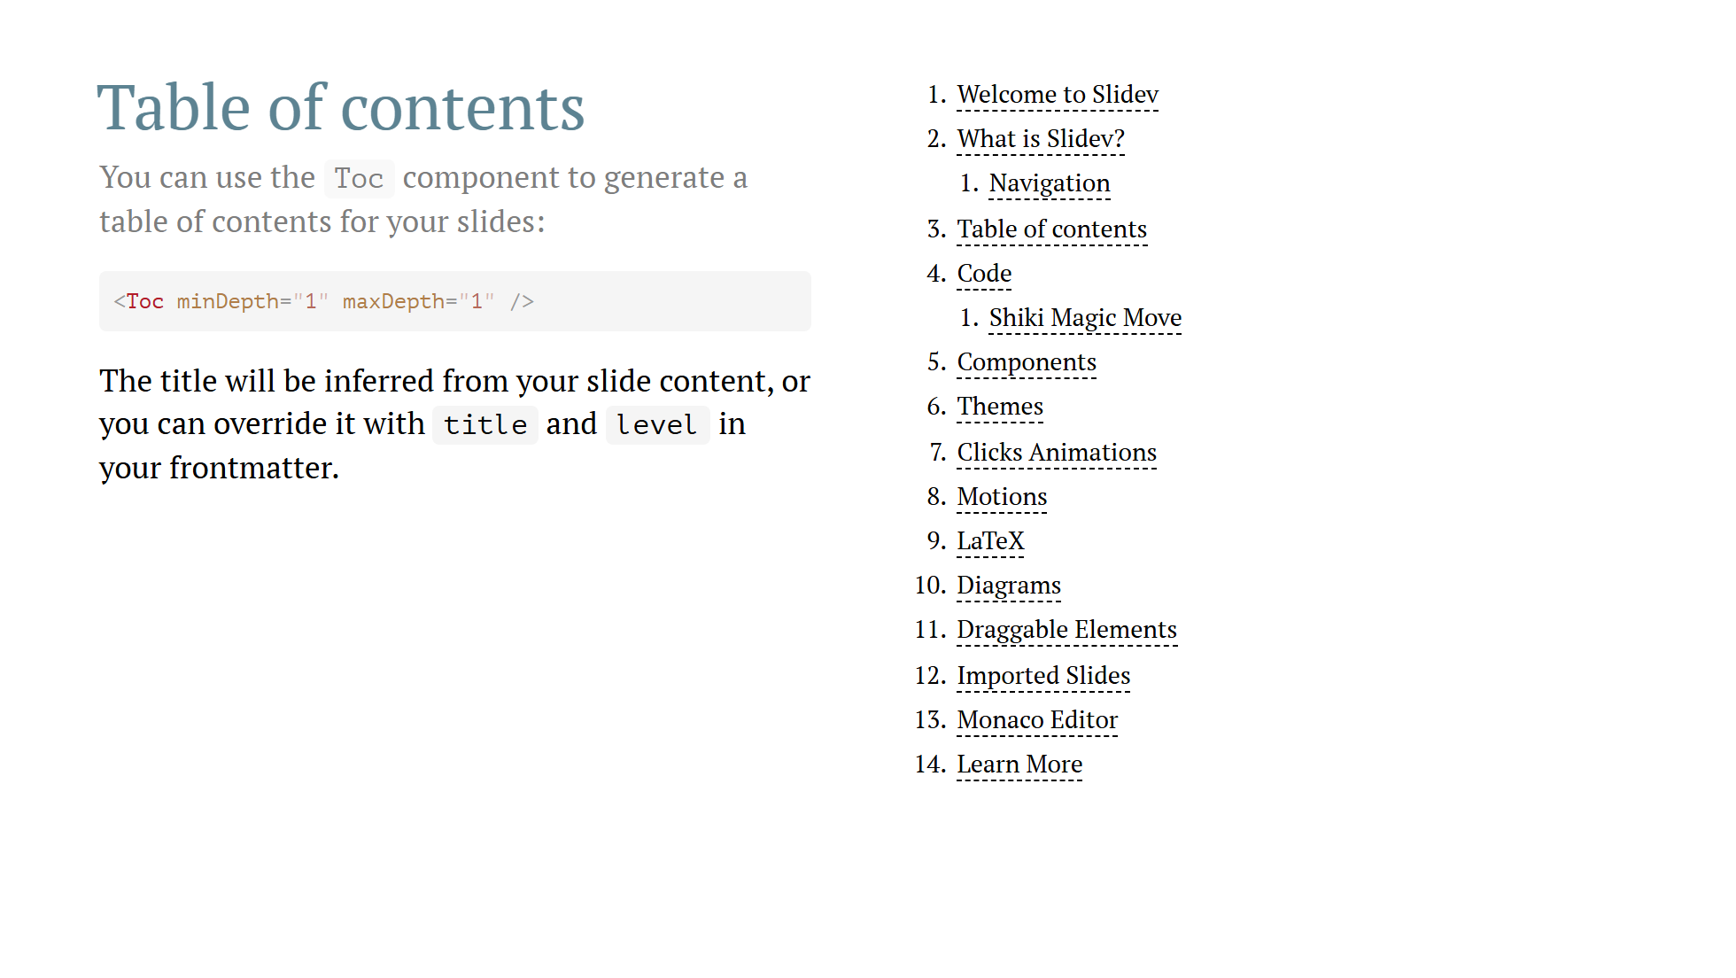

Slide 6
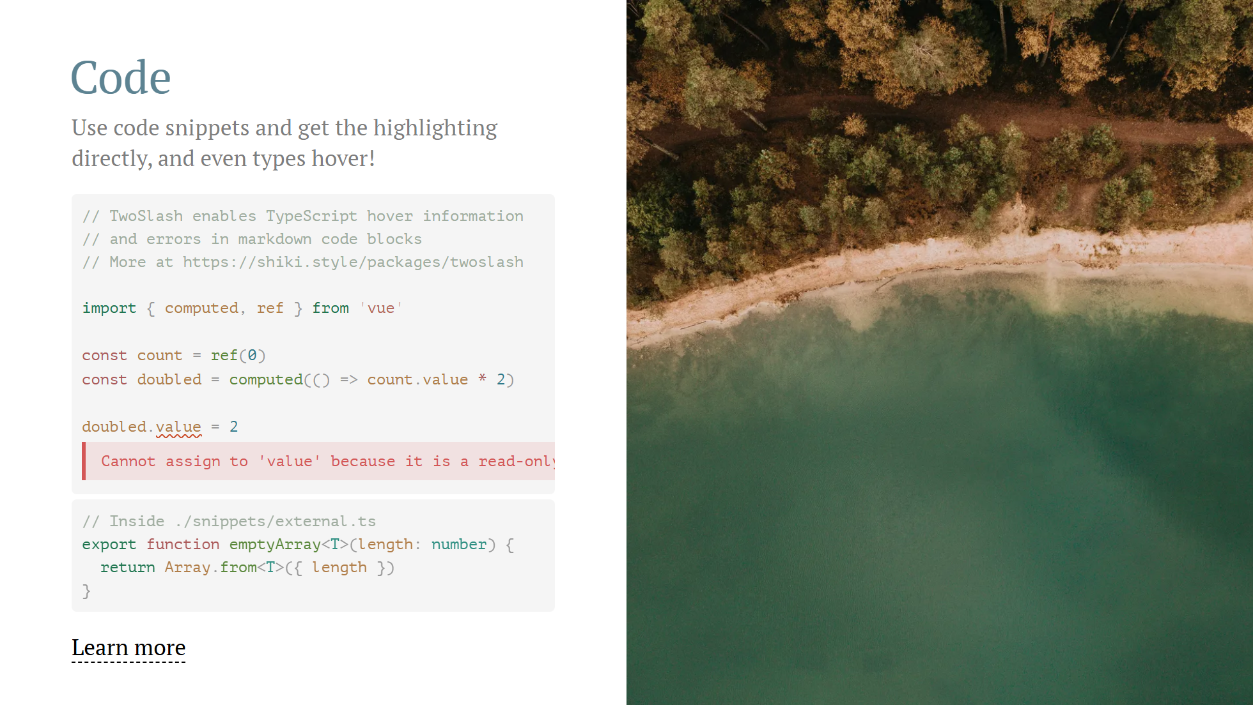
Notes:
Notes can also sync with clicks [click] This will be highlighted after the first click [click] Highlighted with `count = ref(0)` [click:3] Last click (skip two clicks)

Slide 7
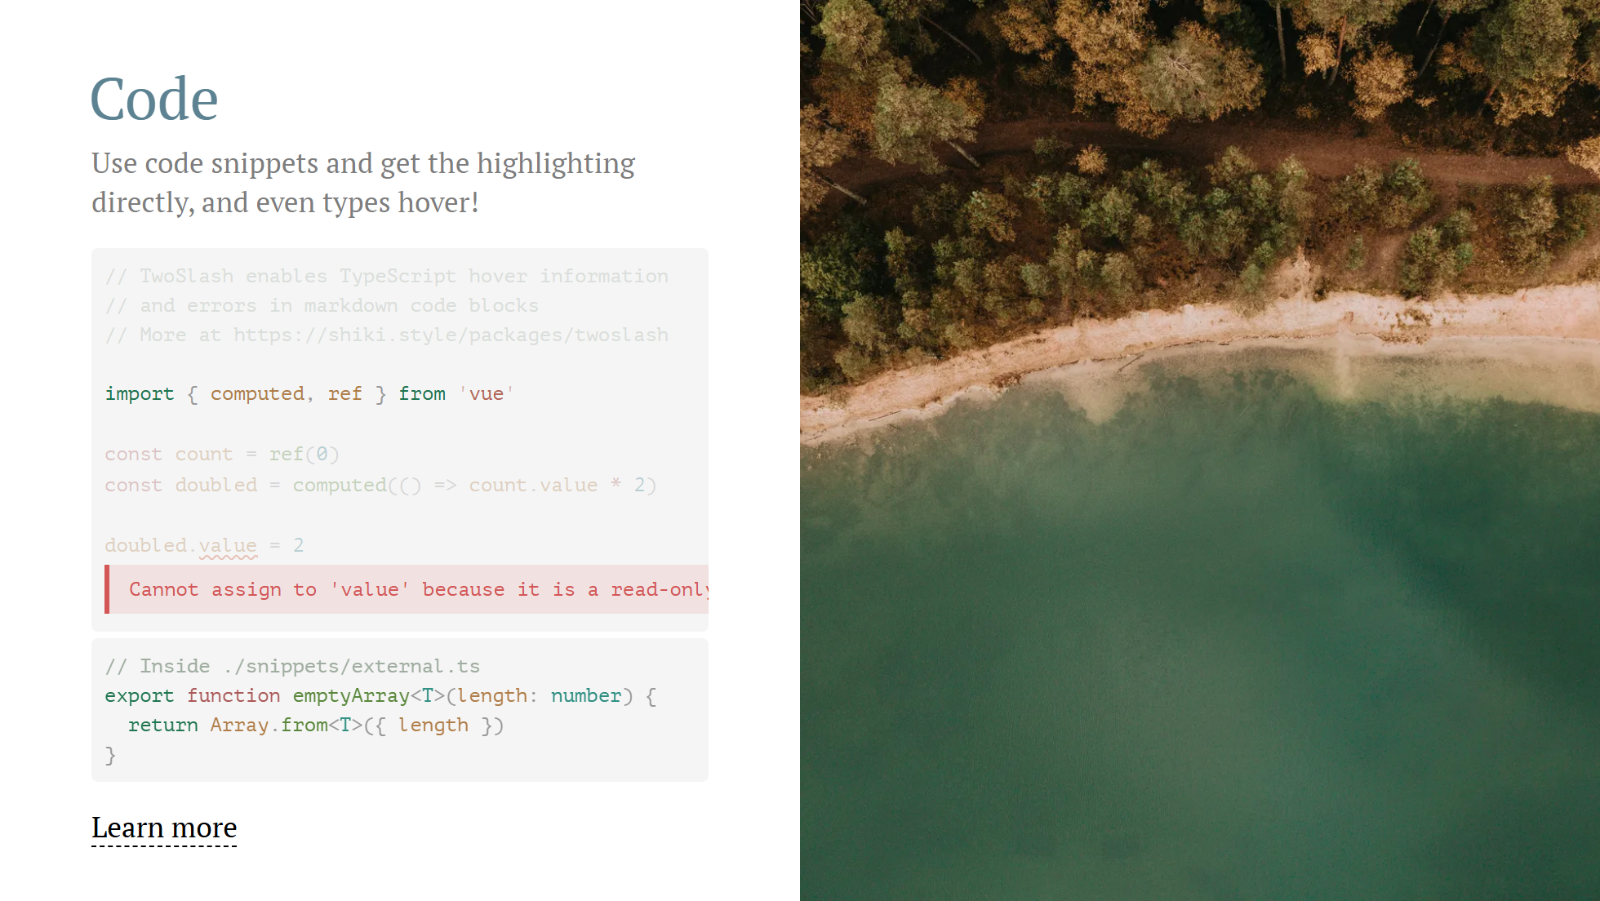
Notes:
Notes can also sync with clicks [click] This will be highlighted after the first click [click] Highlighted with `count = ref(0)` [click:3] Last click (skip two clicks)

Slide 8

Notes:
Notes can also sync with clicks [click] This will be highlighted after the first click [click] Highlighted with `count = ref(0)` [click:3] Last click (skip two clicks)

Slide 9

Notes:
Notes can also sync with clicks [click] This will be highlighted after the first click [click] Highlighted with `count = ref(0)` [click:3] Last click (skip two clicks)

Slide 10

Notes:
Notes can also sync with clicks [click] This will be highlighted after the first click [click] Highlighted with `count = ref(0)` [click:3] Last click (skip two clicks)

Slide 11
Notes:
Notes can also sync with clicks [click] This will be highlighted after the first click [click] Highlighted with `count = ref(0)` [click:3] Last click (skip two clicks)

Slide 12
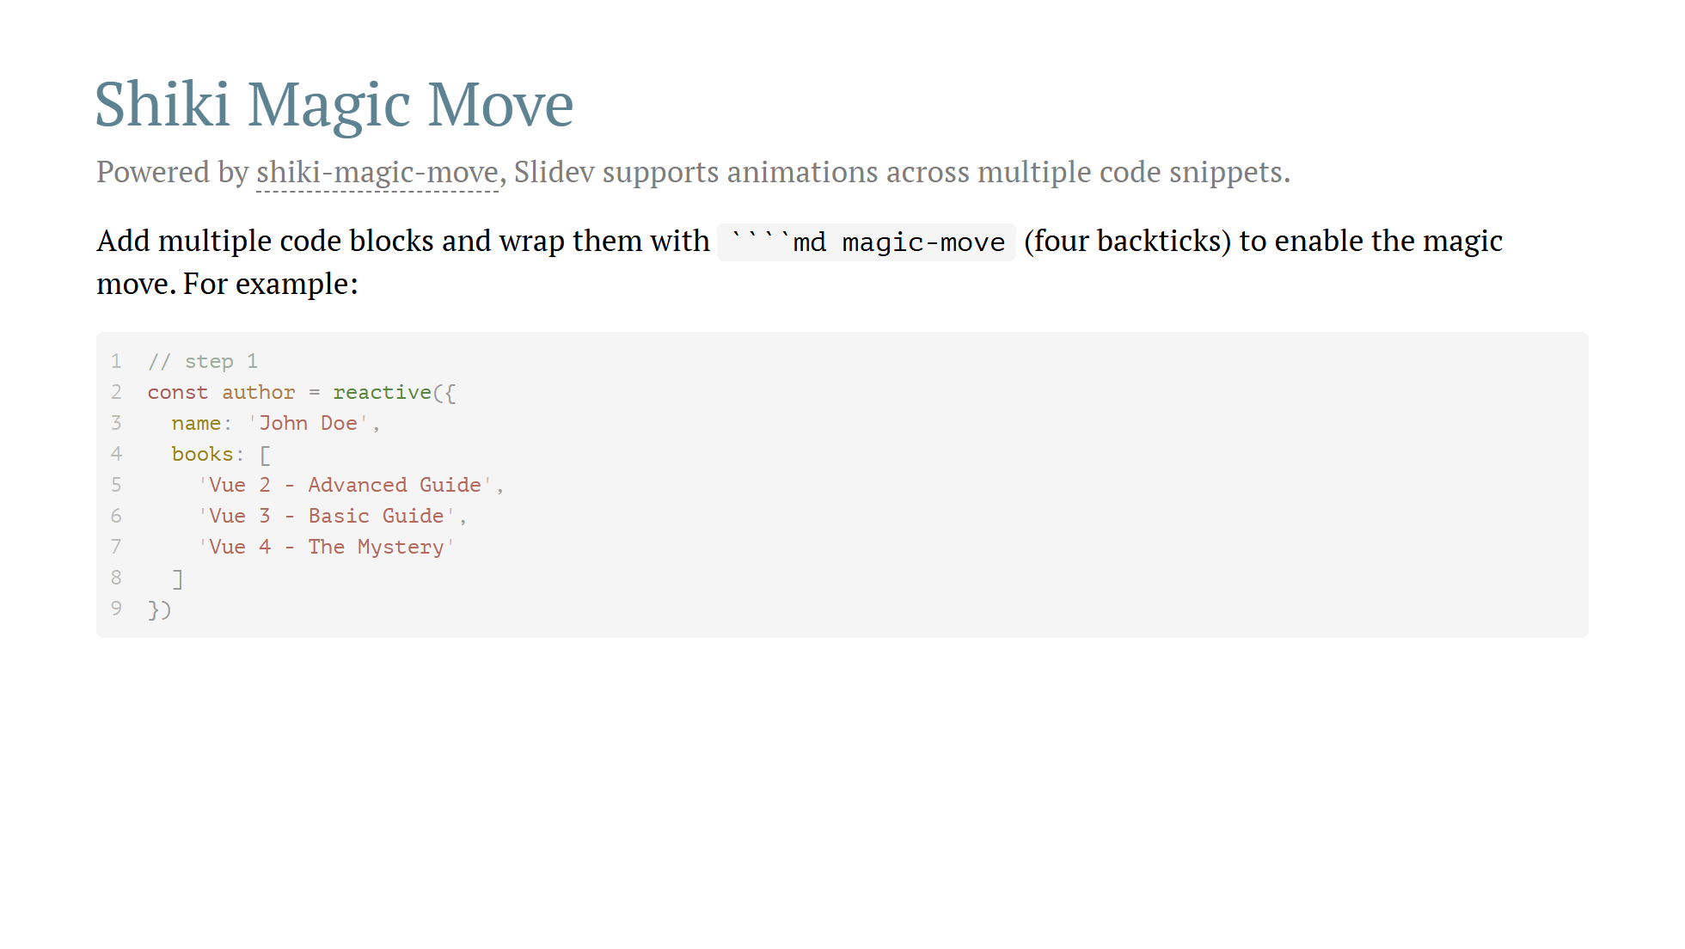

Slide 13
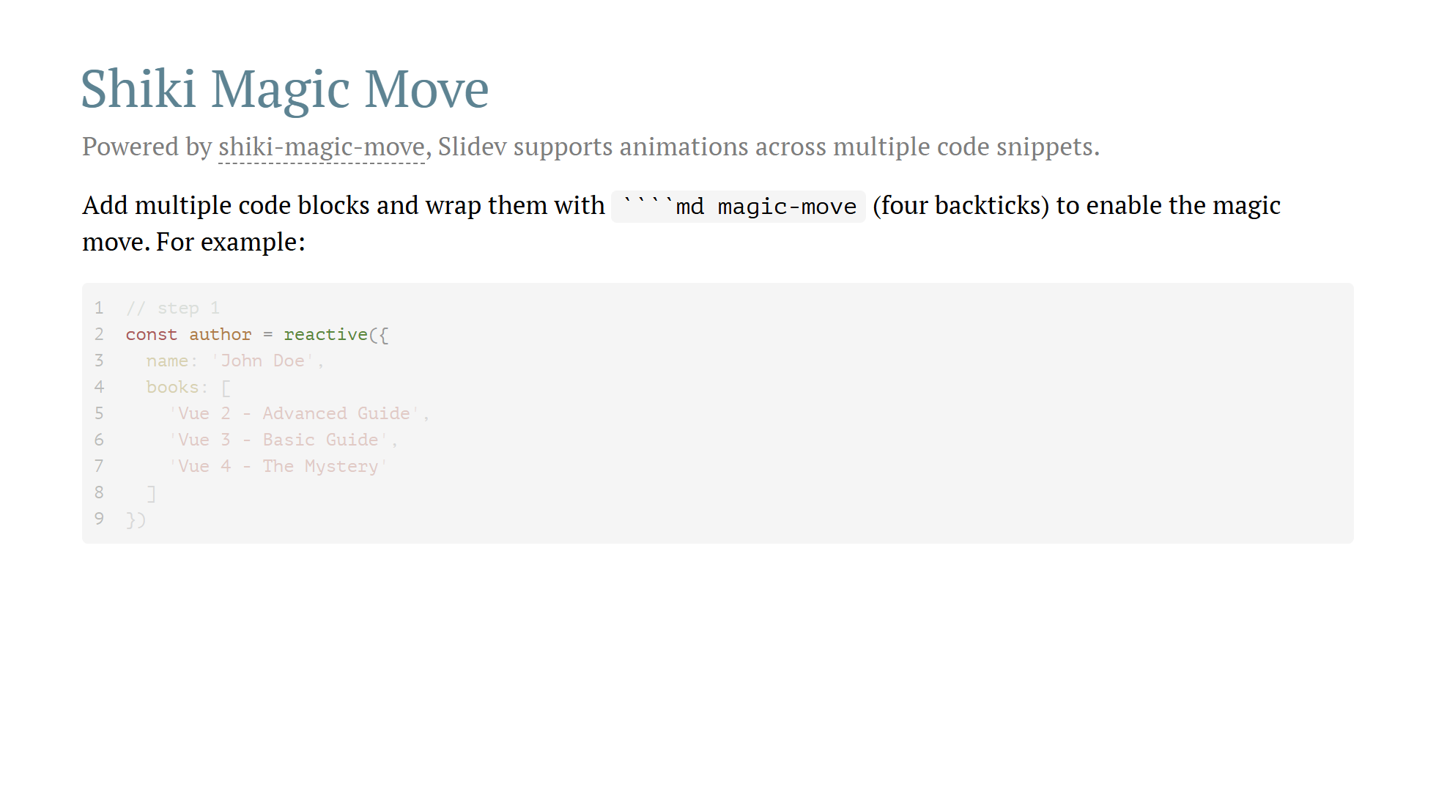

Slide 15
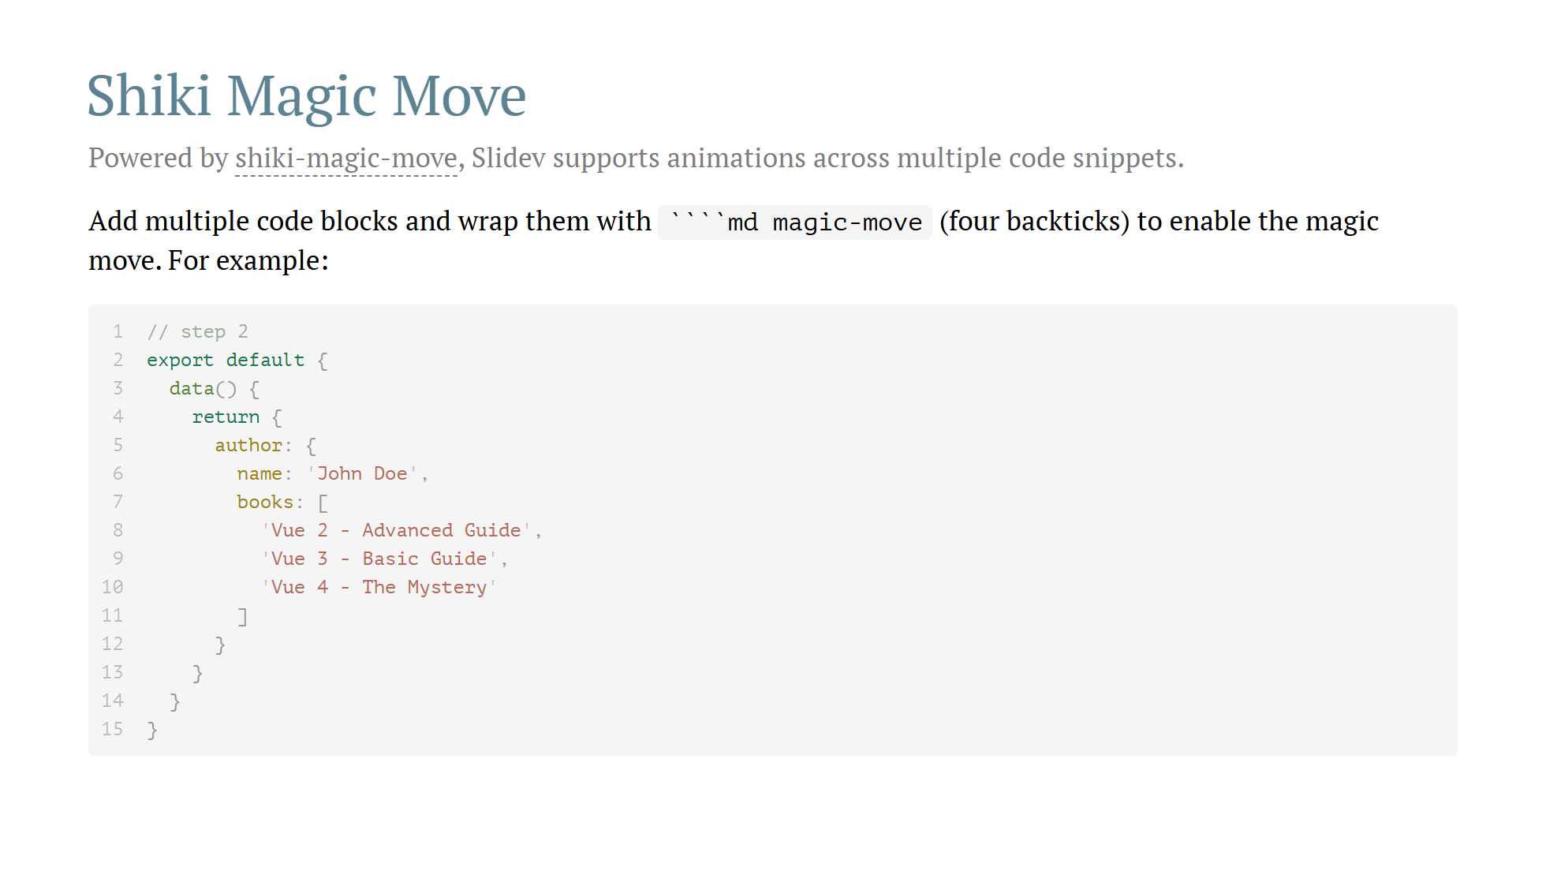

Slide 16
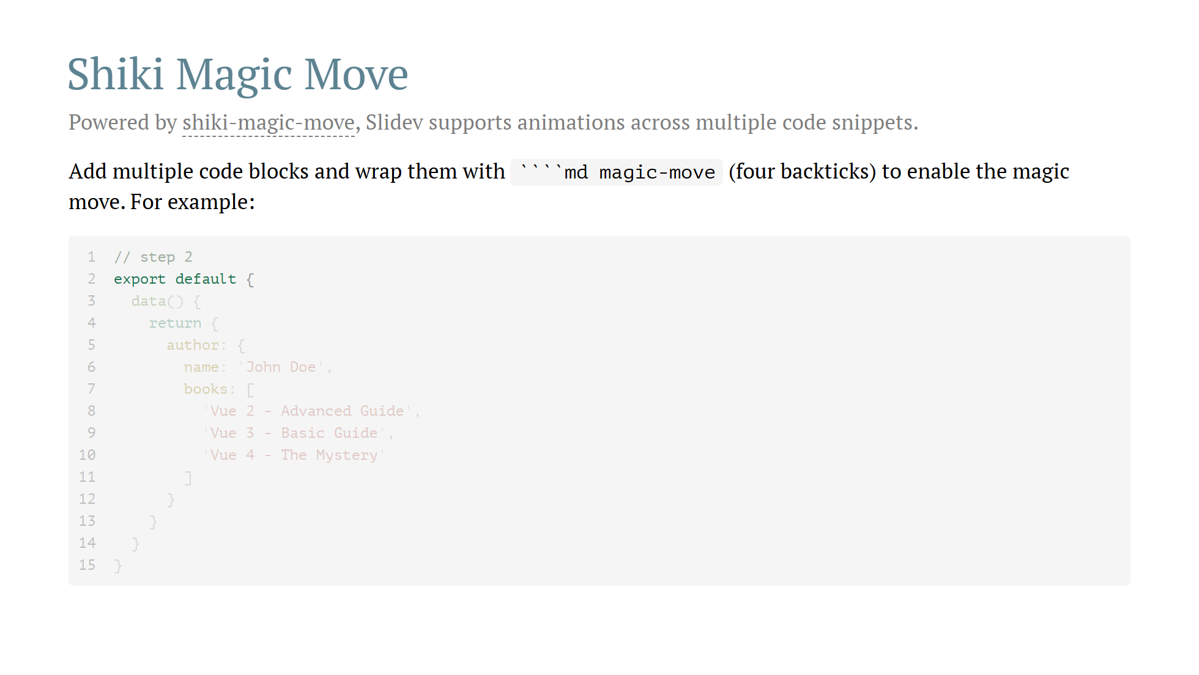

Slide 17
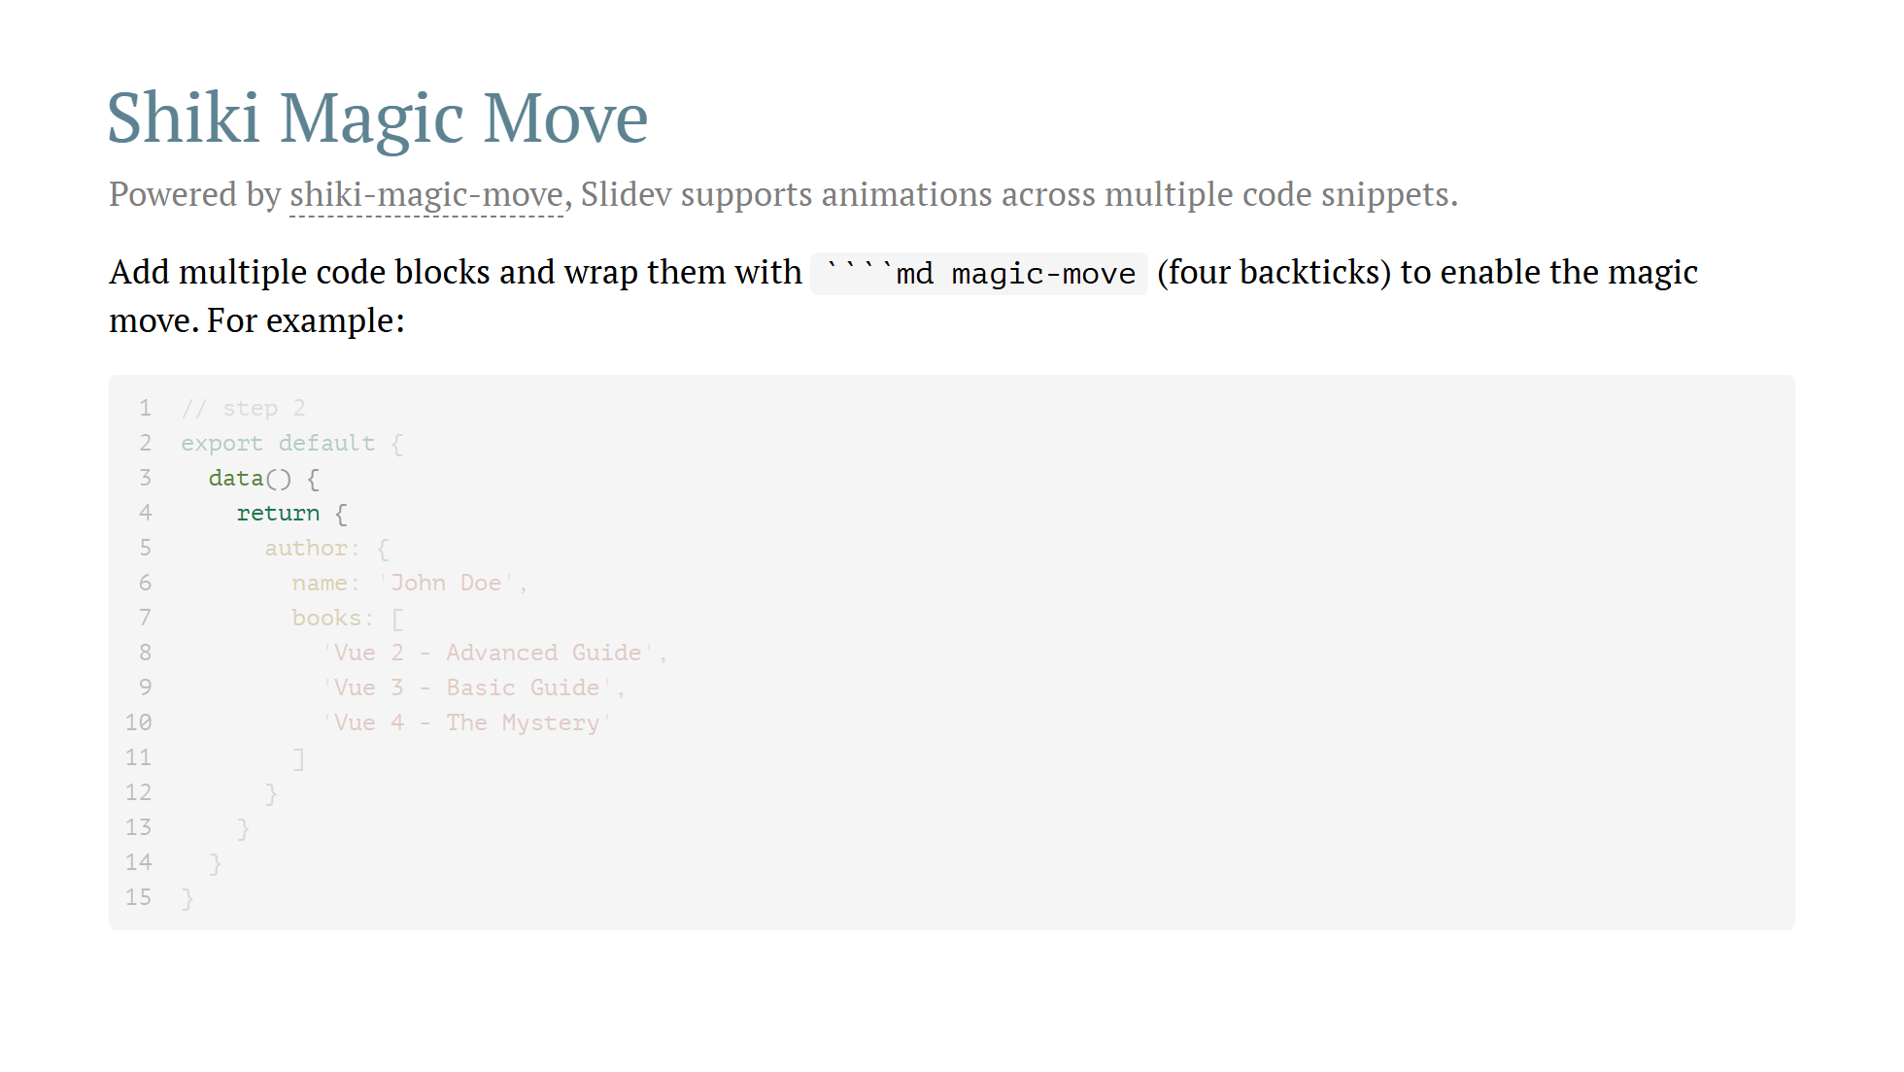

Slide 18
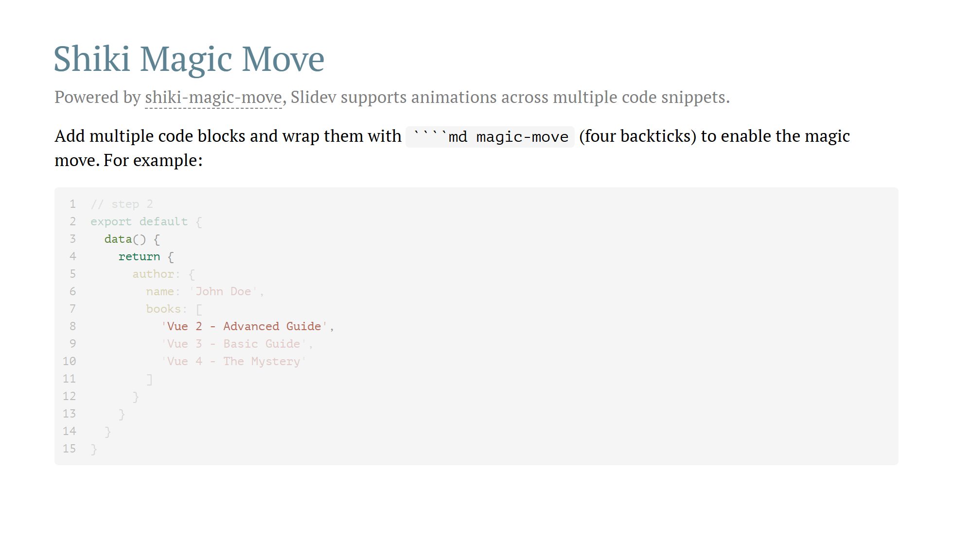

Slide 19
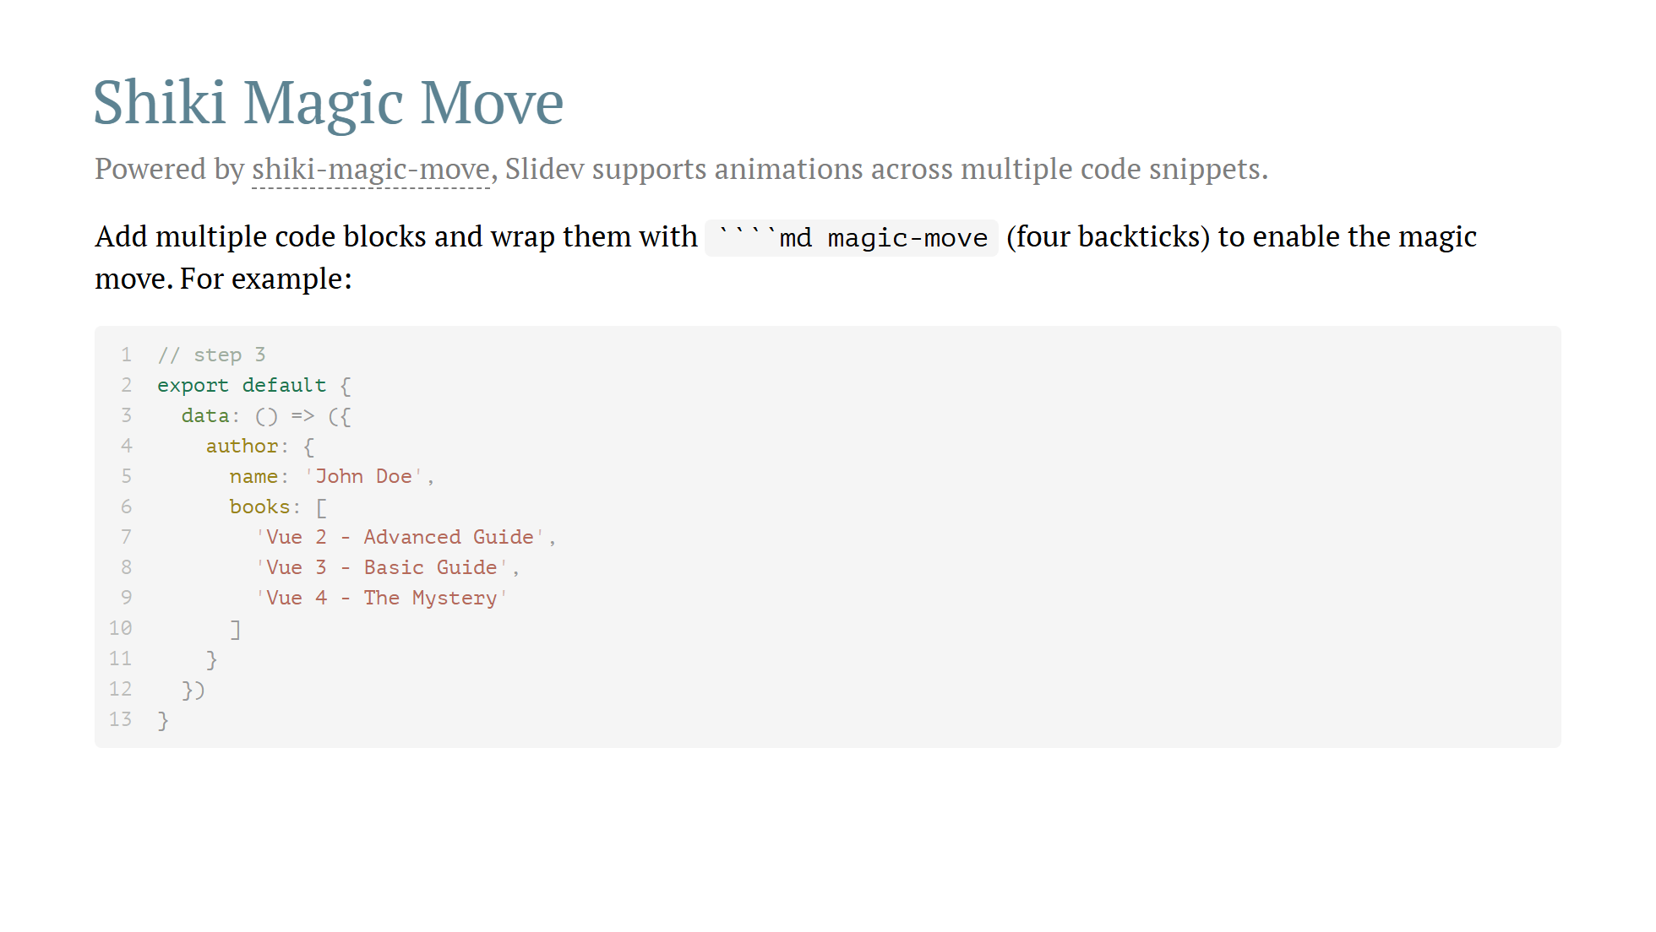

Slide 20
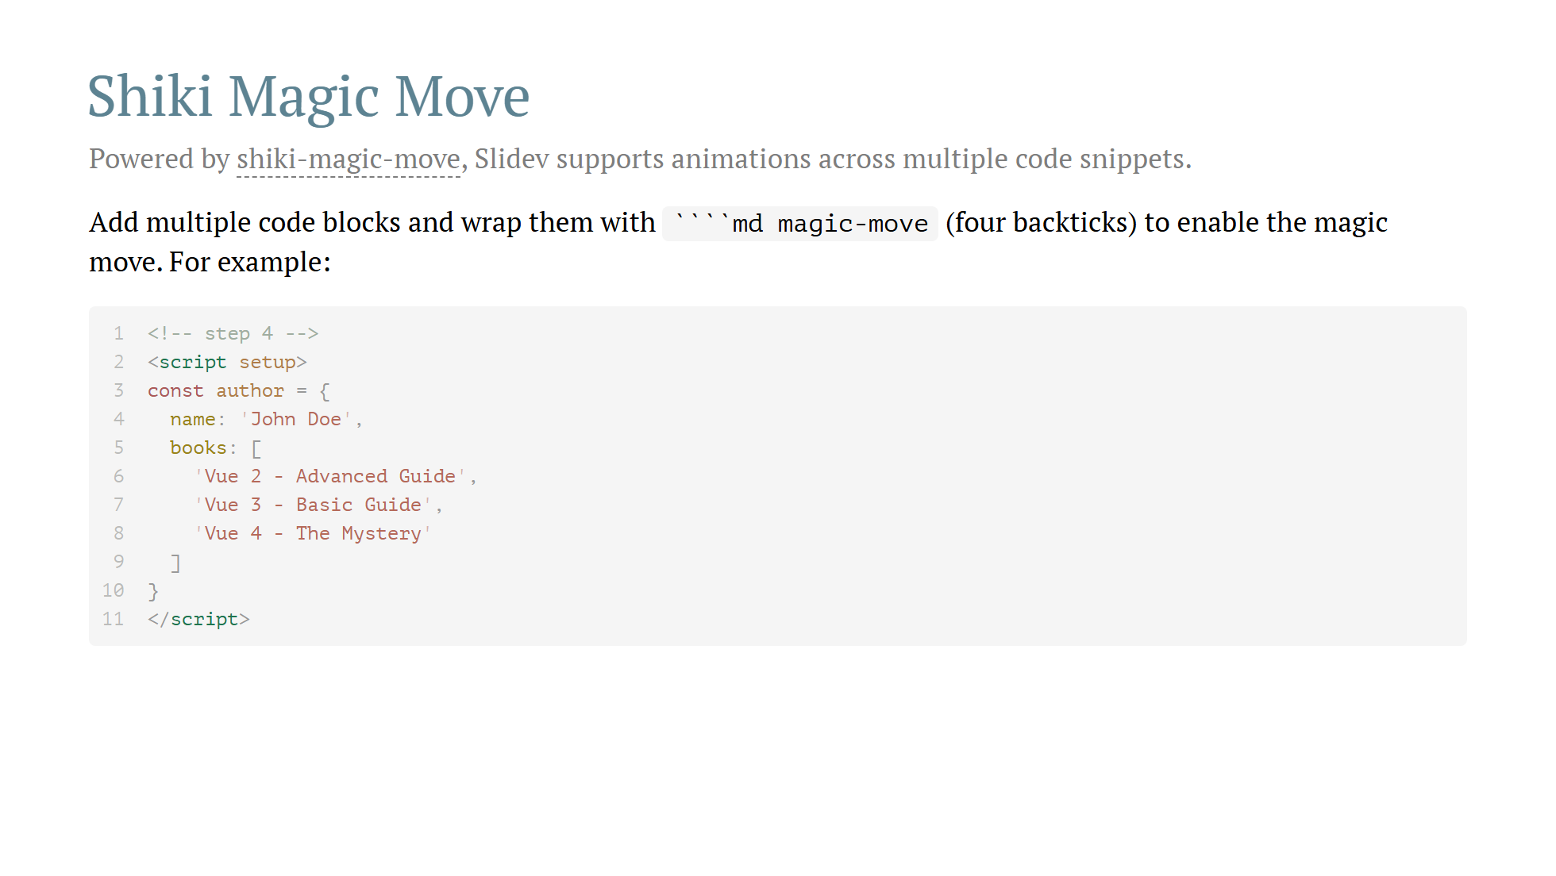

Slide 21
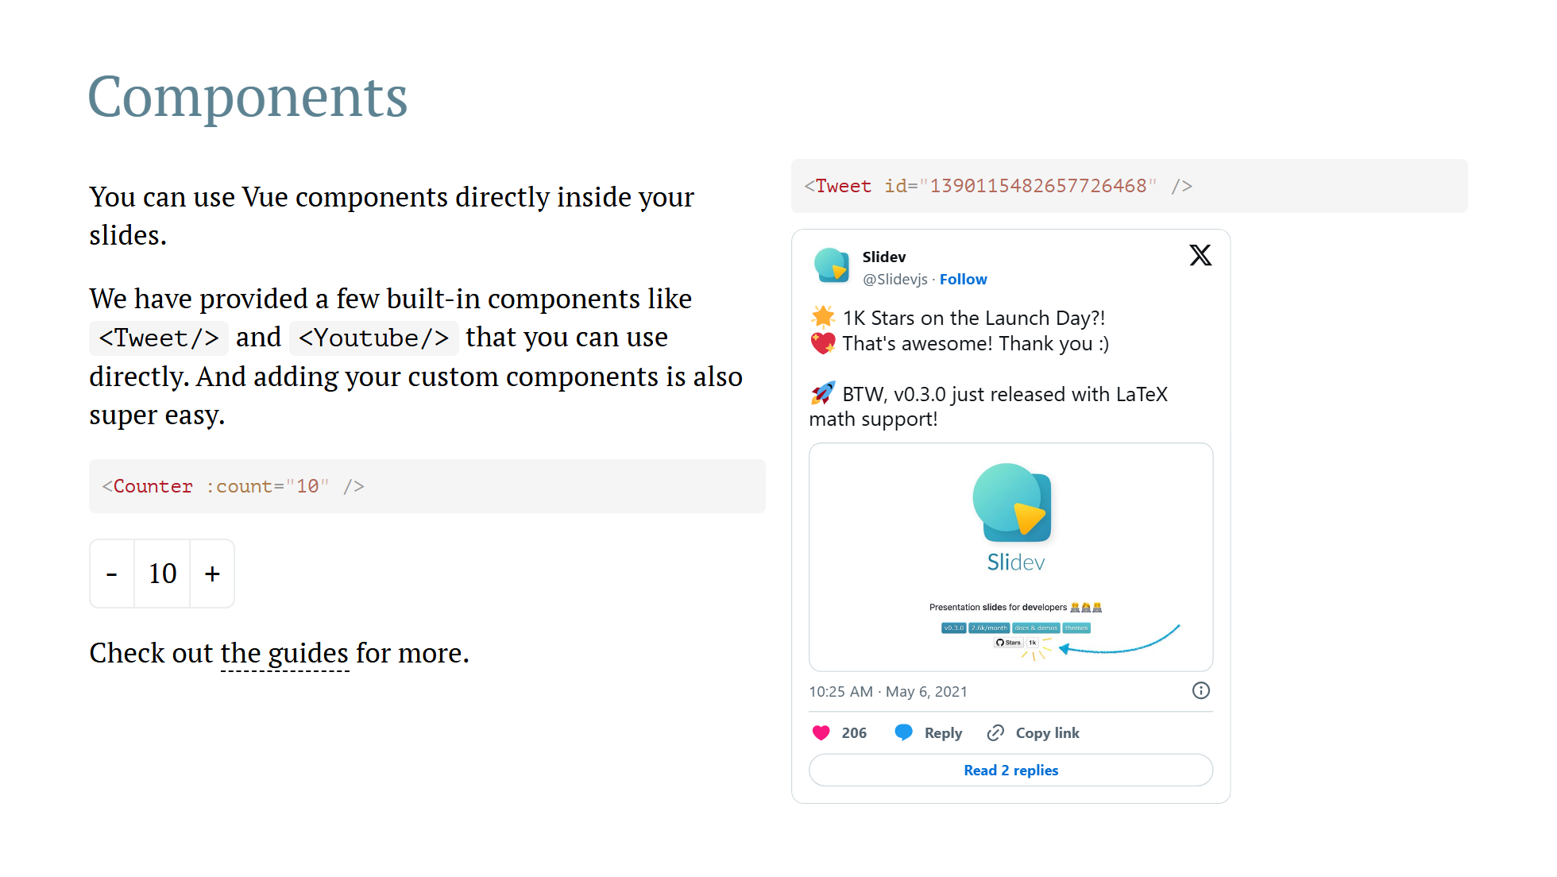
Notes:
Presenter note with **bold**, *italic*, and ~~striked~~ text. Also, HTML elements are valid: <div class="flex w-full"> <span style="flex-grow: 1;">Left content</span> <span>Right content</span> </div>

Slide 22
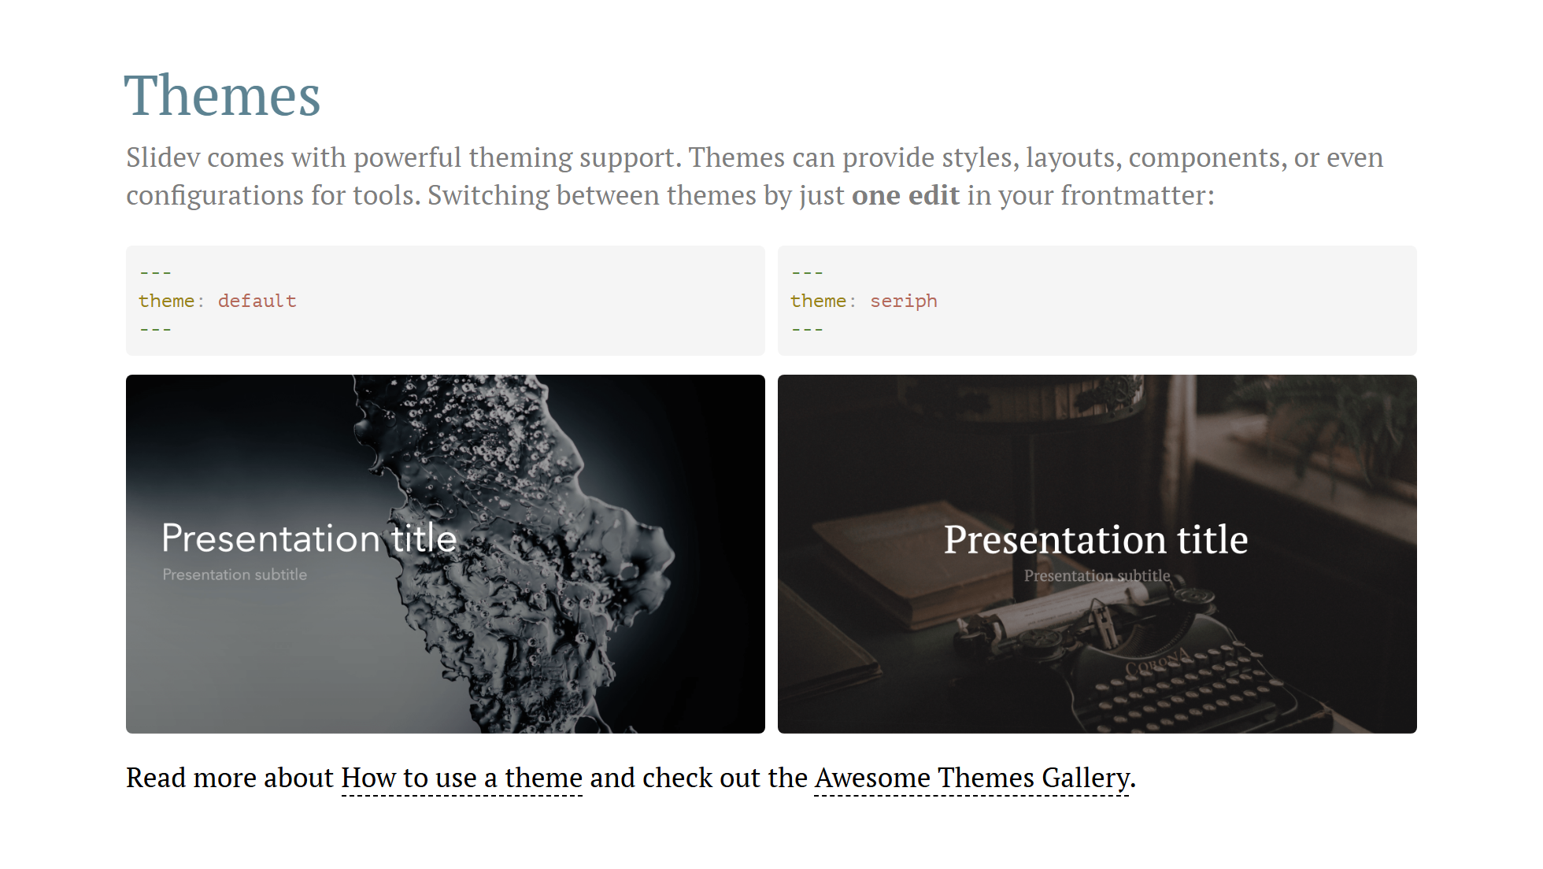

Slide 23
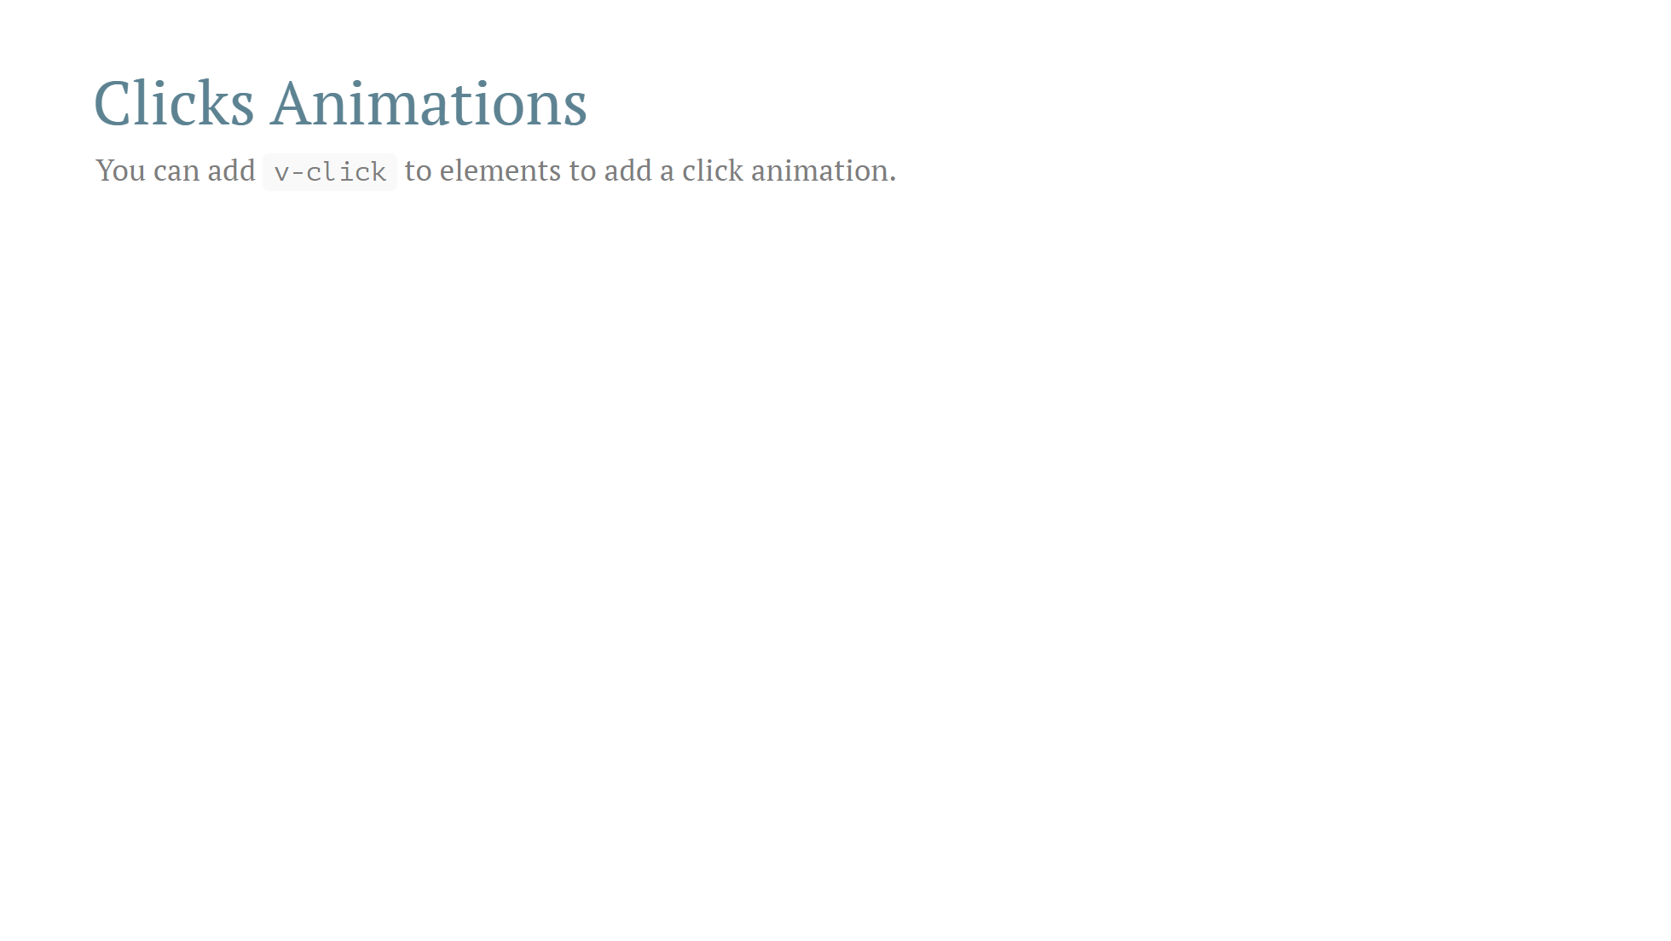

Slide 24
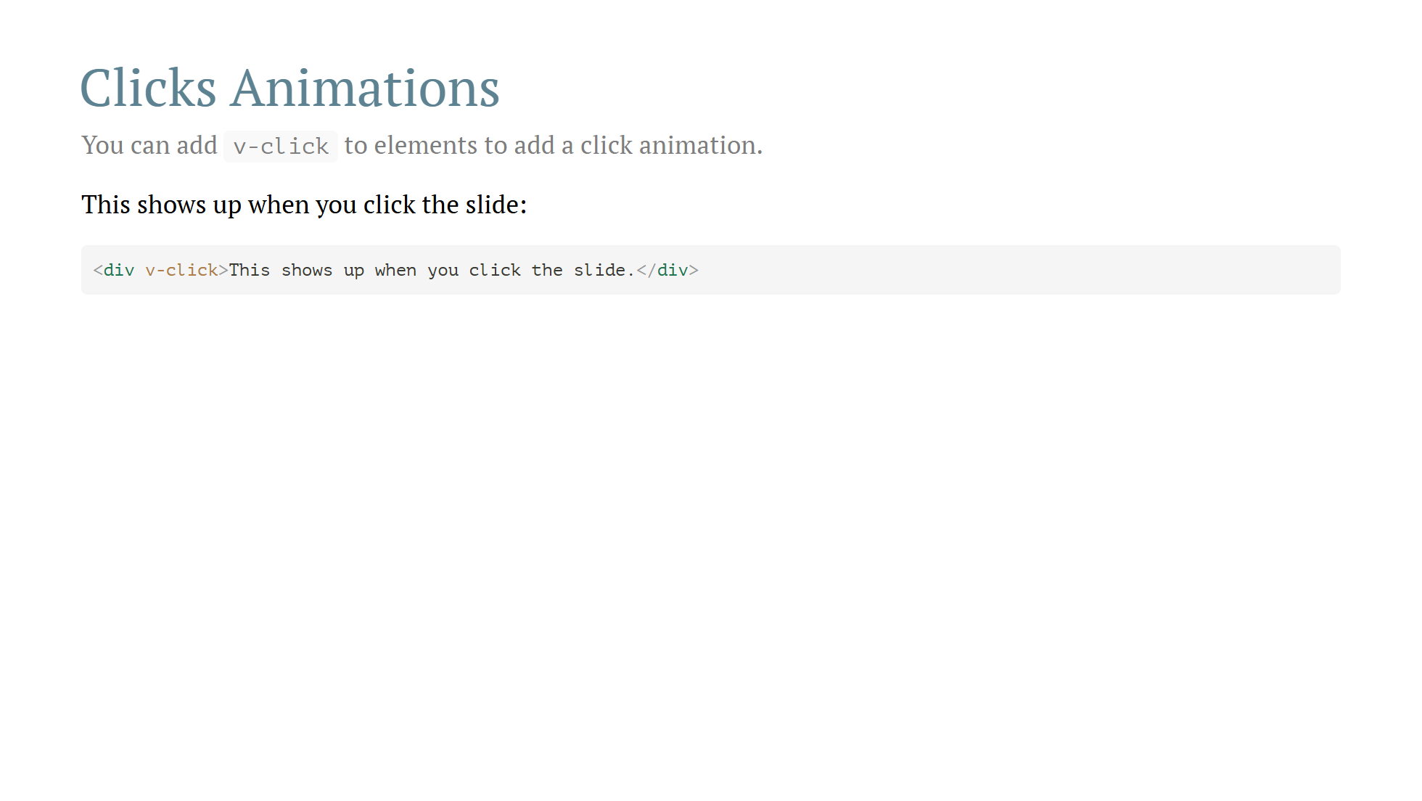

Slide 25
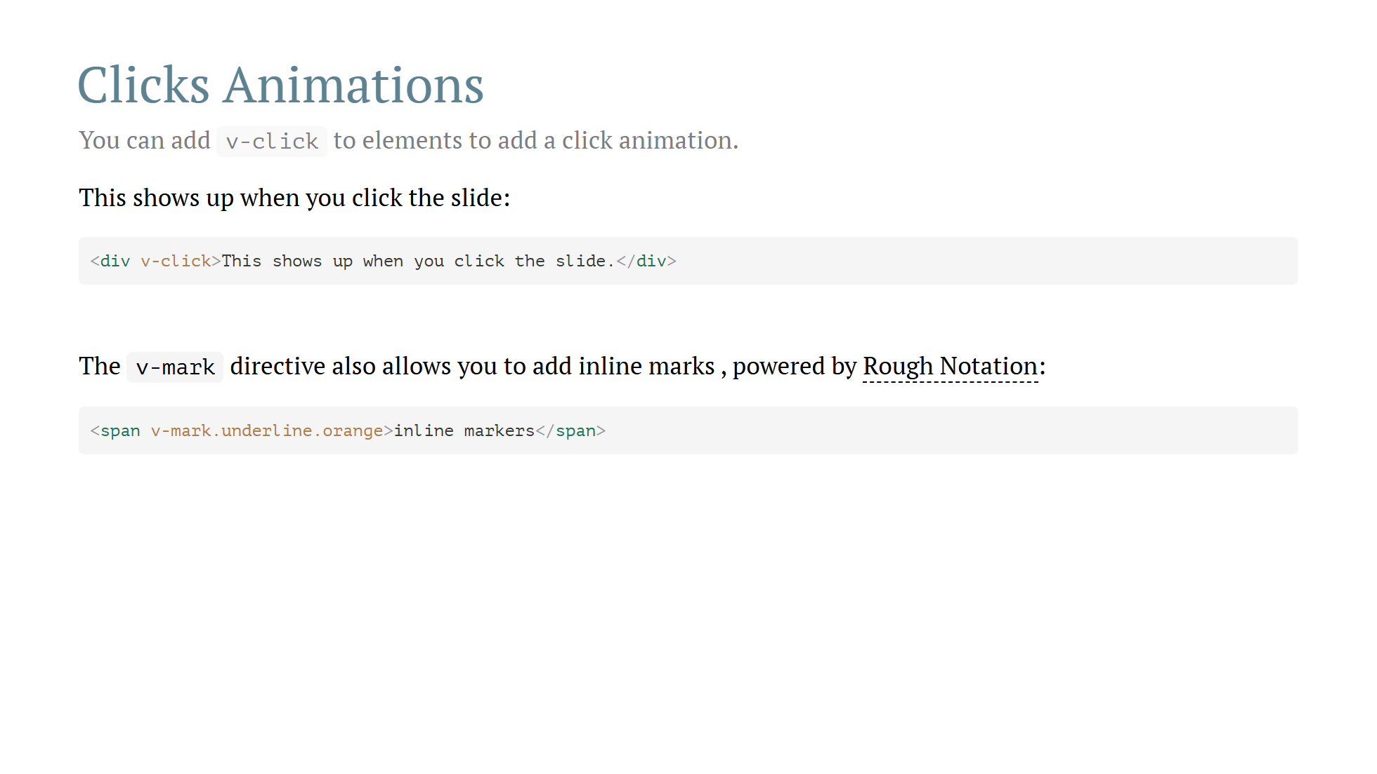

Slide 26
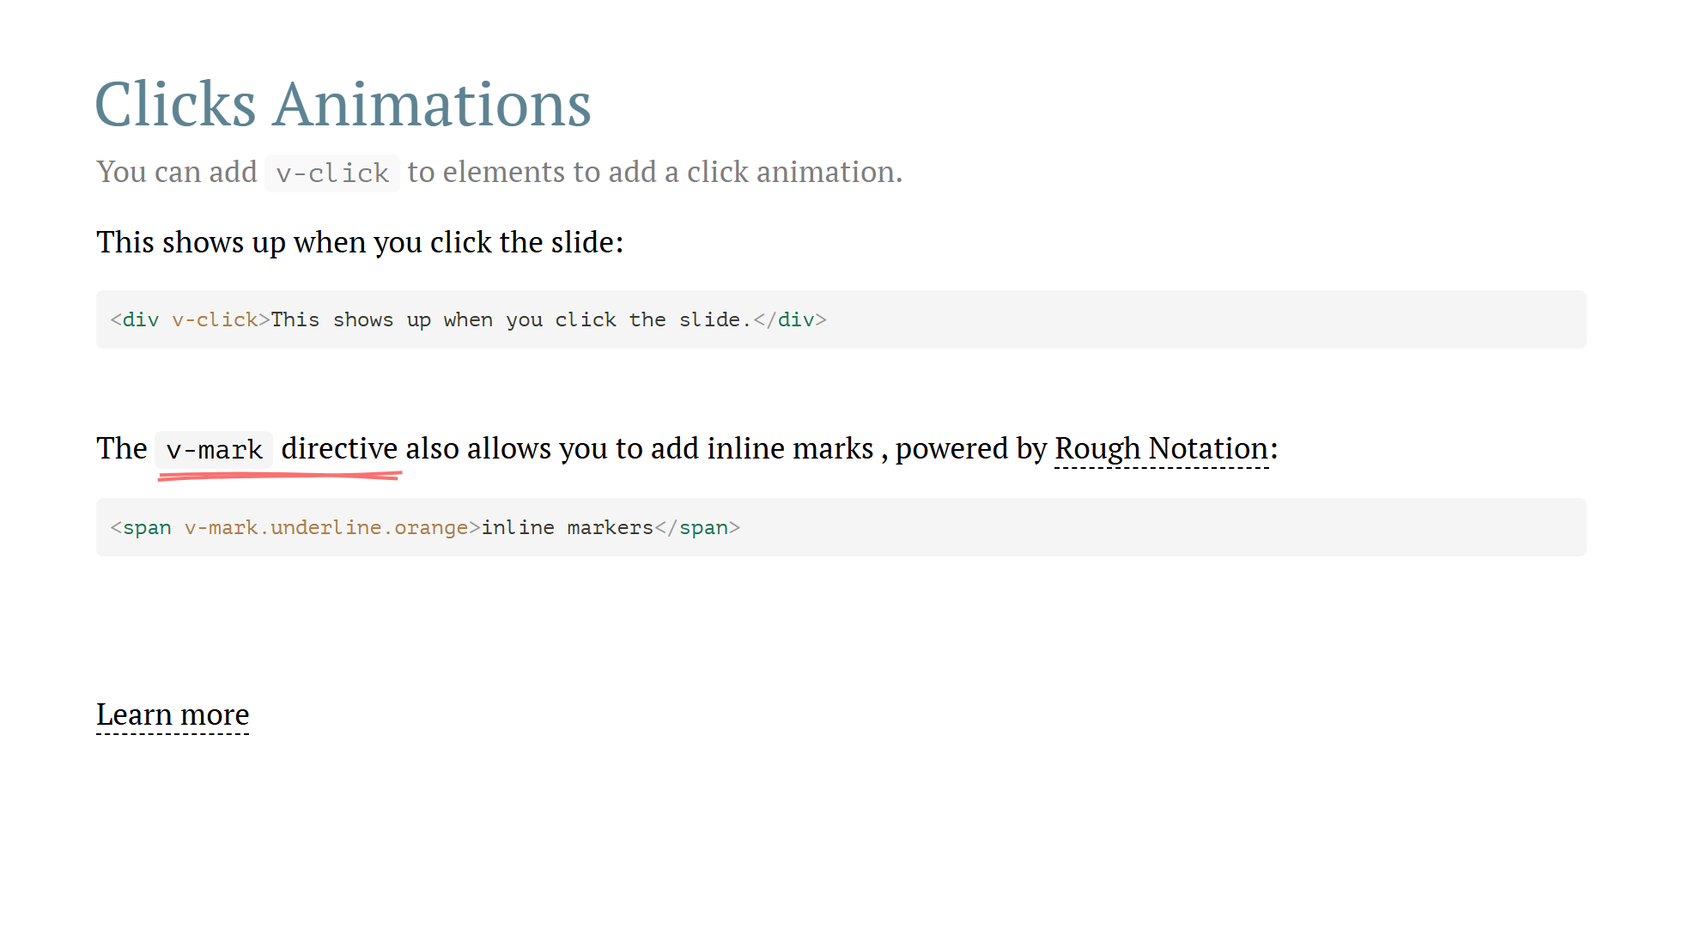

Slide 27
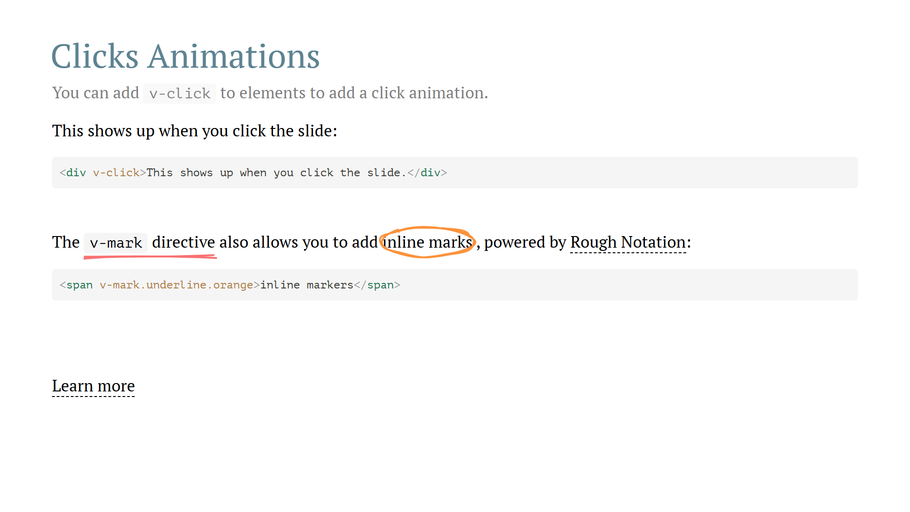

Slide 28
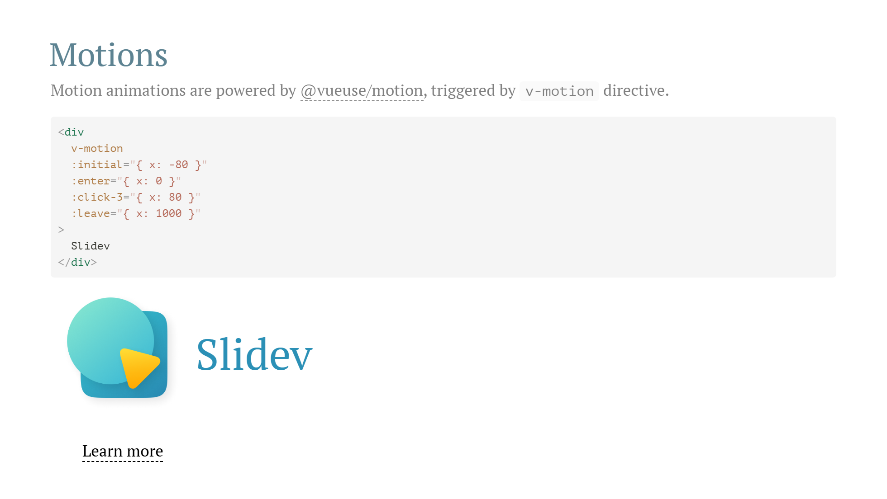

Slide 29
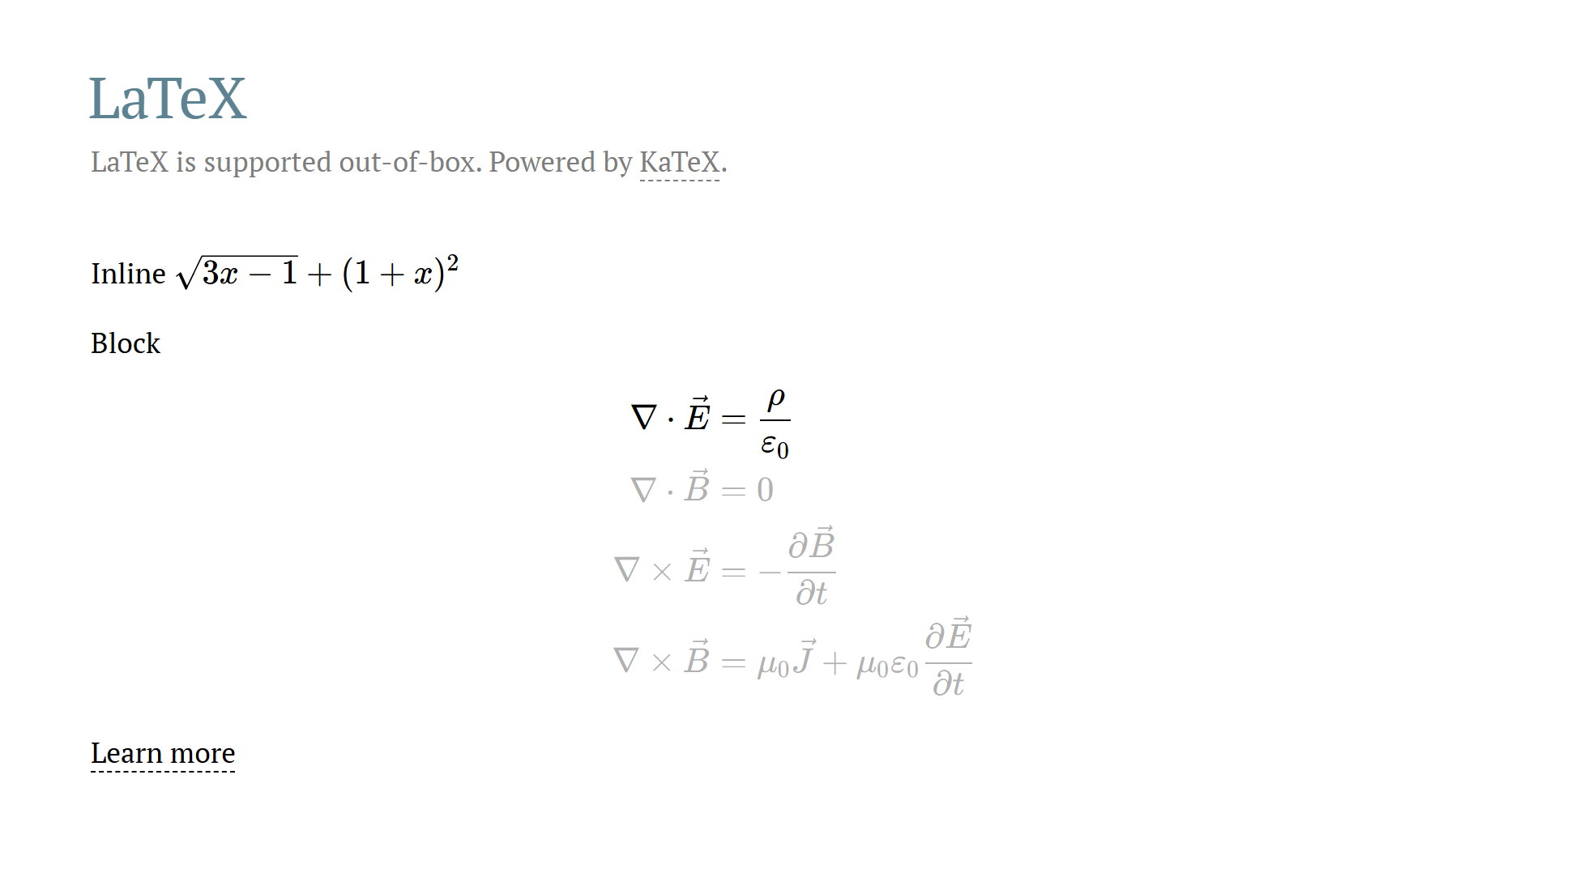

Slide 30
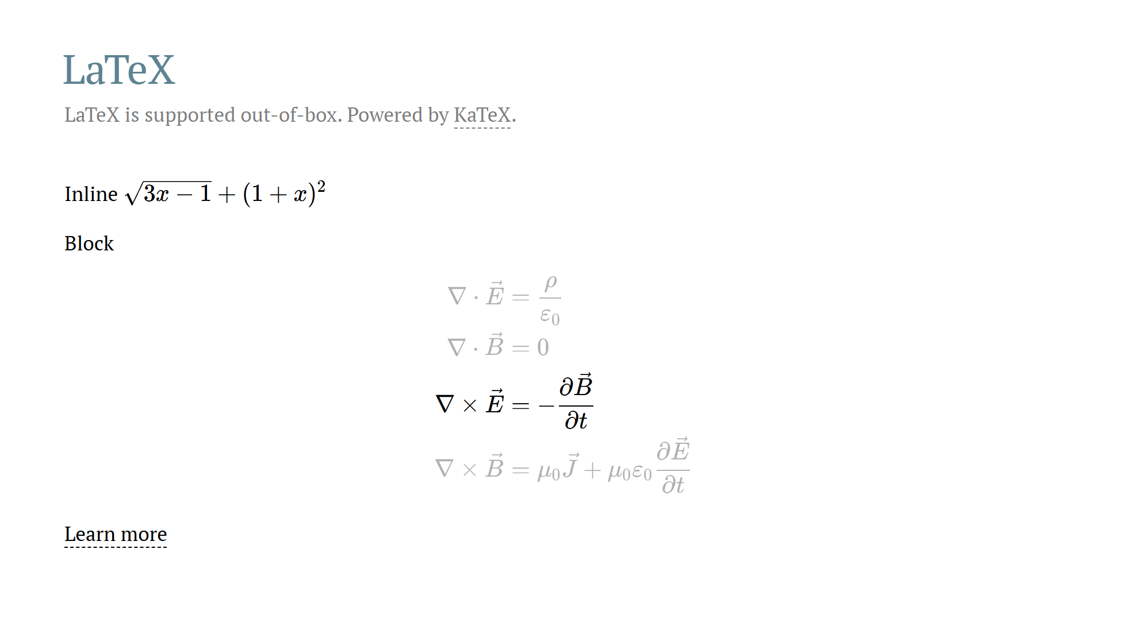

Slide 31
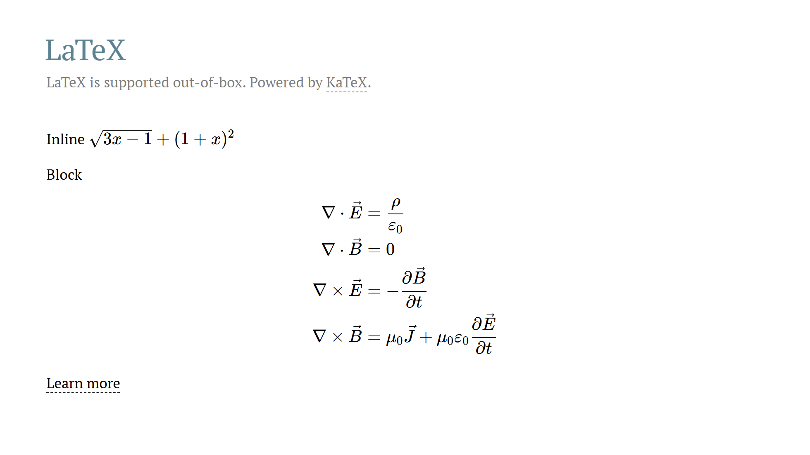

Slide 32
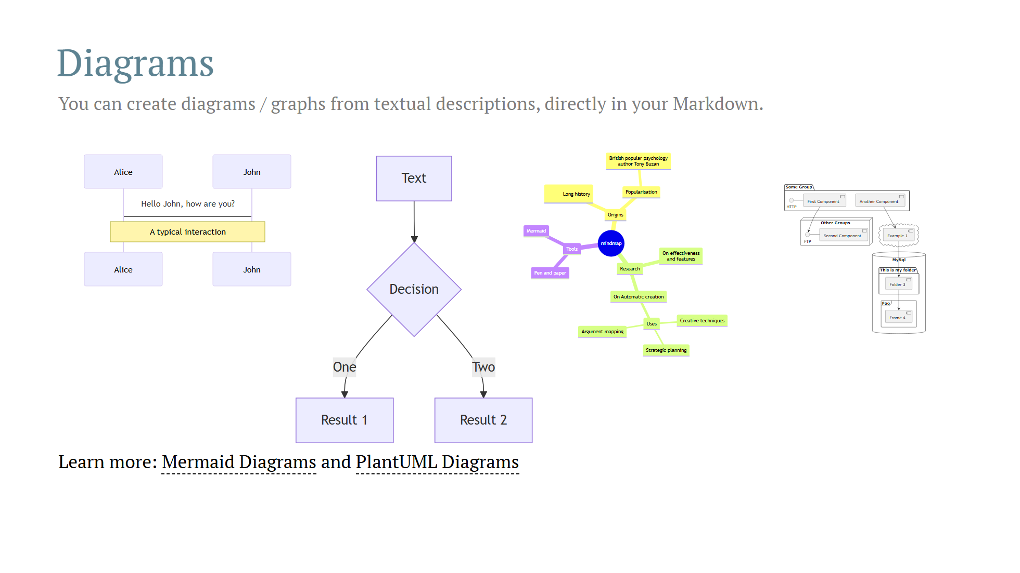

Slide 33
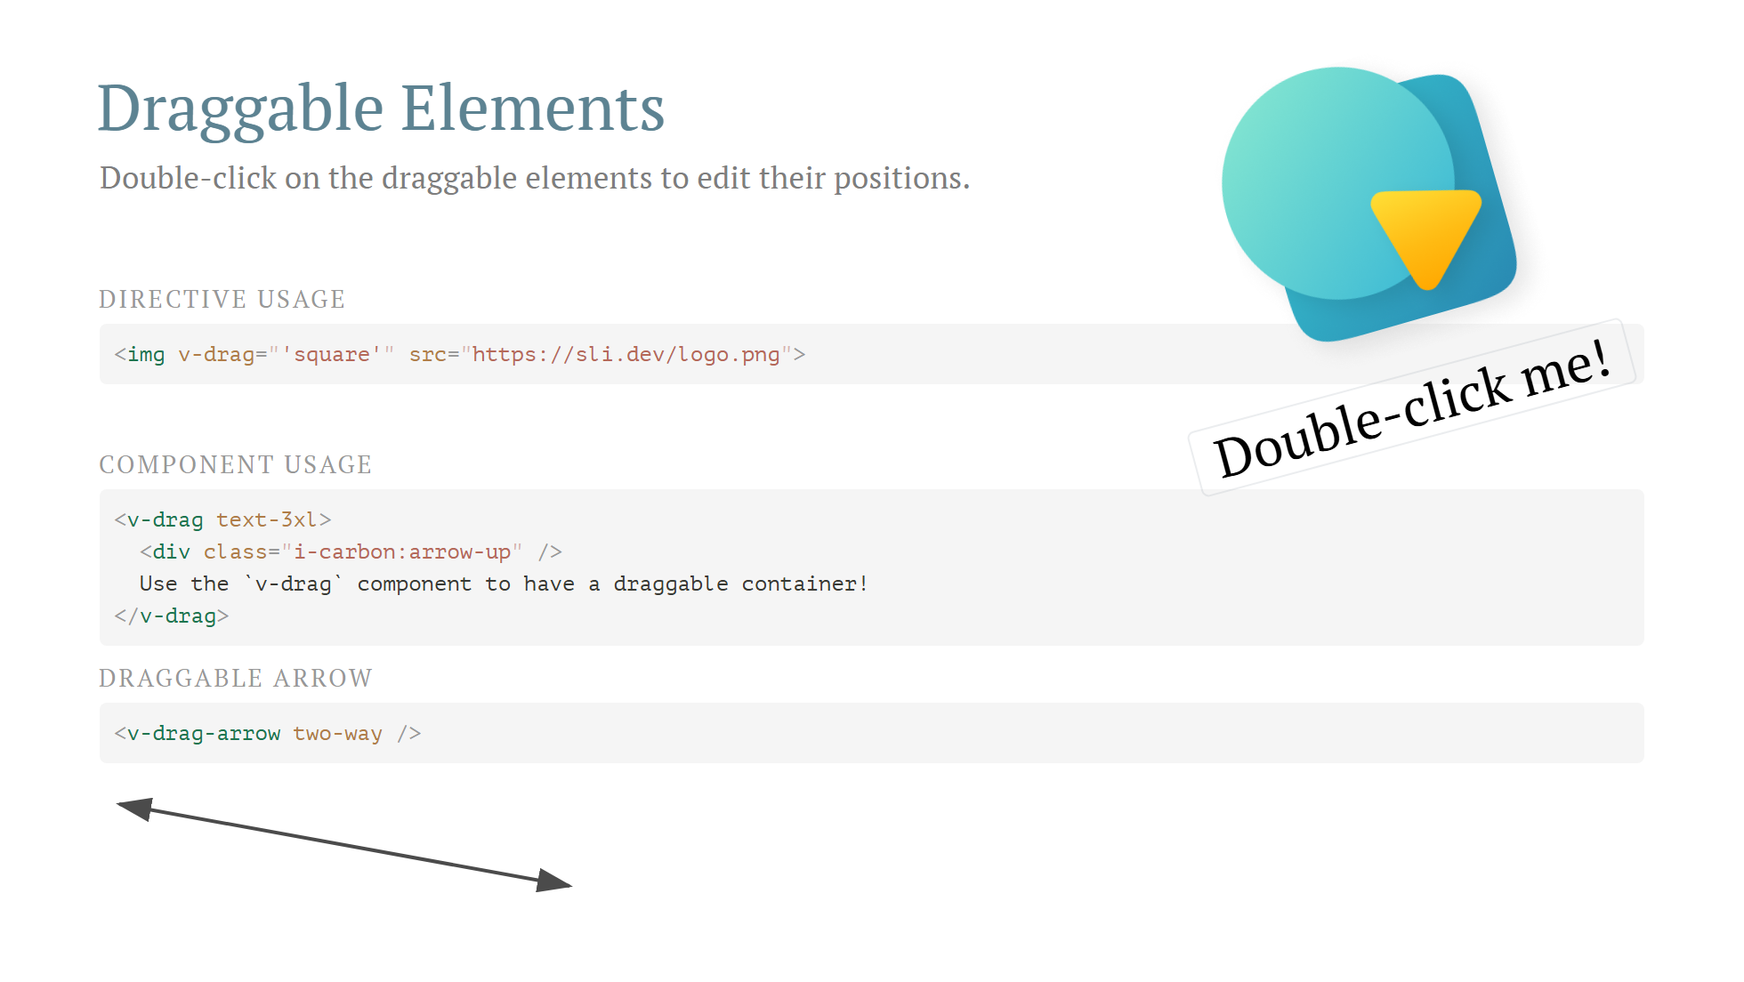

Slide 34
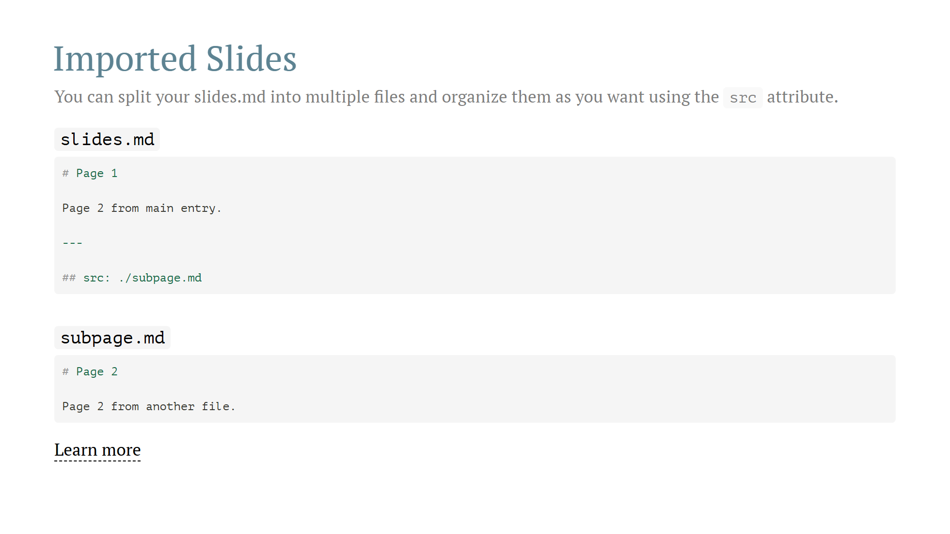

Slide 35
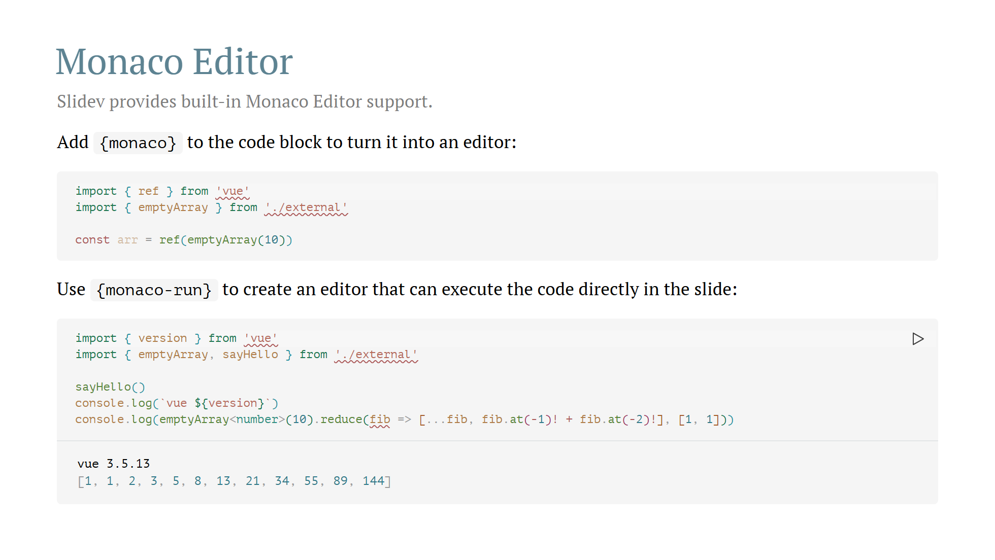

Slide 36


